Slide 1
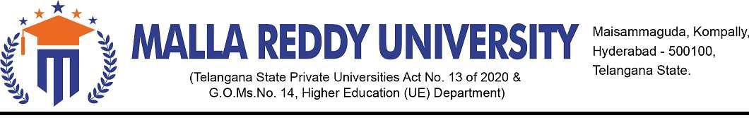
Application Development – Python Explore
An android application based on attendance system using face-recognition
BATCH:-CSE(Sigma)
GROUP:-4
2211CS010361:-M.VAISHNAVI
2211CS010370:-M.SANTHOSH REDDY
2211CS010393:-M.ROHITH REDDY
2211CS010425:-P.LAXMI PRASANNA
2211CS010443:-P.VAMSI VARDHAN REDDY
UNDER THE ESTEEMED GUIDANCE OF
Mr.V.Gopi Tilak (Assistance Prof.. CSE)

Slide 2
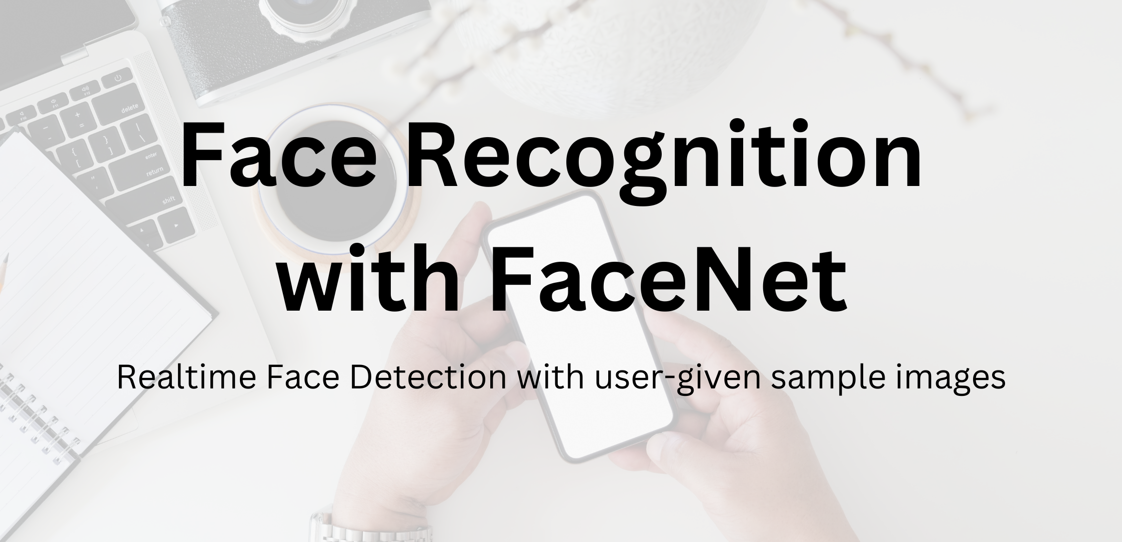

Slide 3
AGENDA :
Abstract
Introduction​
Need for the Project
​Features of the Project
Technologies employed
Proposed system
Working
System requirements
Flow chart & Screen shorts
limitations
​Conclusion
Future work

Slide 4
Abstract :
In many of the educational institutions, managing attendance of students/candidates is tedious, as there would be large number of students in the class and keeping track of all is onerous. There are situations where student act as proxies for their friends even though they are not present. This system,which is based on face detection and recognition algorithms,spontaneously detects the student when he enters the class room and marks the attendance by recognizing him. The database is then modified or updated automatically. This reduces time and effort of manually updating the attendance. This system also provides authentication using recognition of face of the admin or teacher to unlock as there are chances of trespassing by the third party. So this rises the security of the system.

Slide 5
Introduction :
With the advent of technology, traditional attendance tracking methods have become outdated and time-consuming. We propose a facial recognition-based attendance system app that leverages the power of Machine Learning to ease the process of attendance marking
Face recognition attendance systems allow instructors to monitor attendance in real-time, giving them the ability to use the app interface at a click and record attendance at ease.

Slide 6

NEED OF THE PROJECT :
OF

Slide 7
Our mobile application will improve the existing attendance systems by providing a more accurate, efficient, and secure way to track attendance, and reduce proxies which will ultimately save time and resources for educational institutions and businesses.
By using face recognition technology, our mobile application will reduce the risk of fraud and errors in attendance tracking, which will help to improve transparency and accountability in various sectors.
With our mobile application, teachers will no longer have to waste time manually signing attendance for each and every student

Slide 8

FEATURES OF PROJECT

Slide 9
Our Android application uses facial recognition technology to track attendance. The application uses the hardware face camera to detect faces in real-time. Faces are matched with the pre existing faces in the internal memory using advanced facial recognition Mobile FaceNet. Initially teachers login from login portal.
If a match is found, the student is marked present for a particular subject on a particular day in the excel document. Attendance is automatically updated in the application's records. This process ensures accurate and reliable attendance tracking and eliminates the need for manual attendance marking
We use Apache POI to create workbooks and excel sheets inside the workbook. The teachers are given the choice to have their own excel file name.

Slide 10
TECHNOIOGIES EMPLOYED :
FaceNet : FaceNet is a face recognition system developed by Google researchers that uses deep learning to recognize human faces in images and videos. It is based on a deep convolutional neural network (CNN) architecture that is trained on a large dataset of face images to learn a representation of a face that is invariant to changes in pose, lighting, and expression.

Slide 11
CHALLENGES FACED AND HOW THEY WERE RESOLVED
The major issue faced during the course of the project was integrating the OpenCV application into the Android Studio:
The CV2 python framework for OpenCV is basic and easy to use. Since Android applications are compatible with Java/Kotlin, we had to find a way to resolve this issue
Steps taken to overcome the issue:
We decided to integrate the Android application with Mobile Facenet. Eventhough the implementation is typical in android studio, our test implementations showed good accuracy and smooth execution.

Slide 12
PROPOSED SYSTEM :
FaceNet is a deep convolutional neural network architecture designed for face recognition tasks. The architecture was proposed by researchers at Google in 2015 and has been one of the most widely used and studied face recognition models ever since. The main idea behind FaceNet is to map the face images into a high-dimensional feature space in such a way that the Euclidean distance between the feature vectors of two faces represents their similarity.

Slide 13
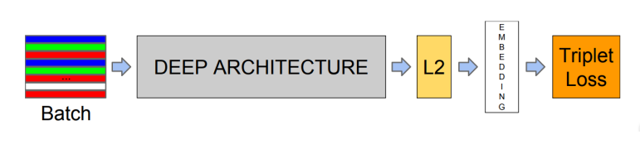
FaceNET Architecture

Slide 14
Input Processing:
In this part, the input face image is processed to generate a fixed-size representation. The input face image is first resized to a fixed size, and then the pixels are normalized to have zero mean and unit variance.
Feature Extraction:
In this part, the processed image is fed through a deep neural network that extracts high-level features from the image.The neural network used in FaceNet is a deep convolutional neural network (CNN), which is composed of multiple convolutional layers, pooling layers, and fully connected layers. The CNN learns a hierarchical representation of the face image, where the lower layers learn low-level features, such as edges and textures, and the higher layers learn more abstract features, such as facial features and expressions.

Slide 15
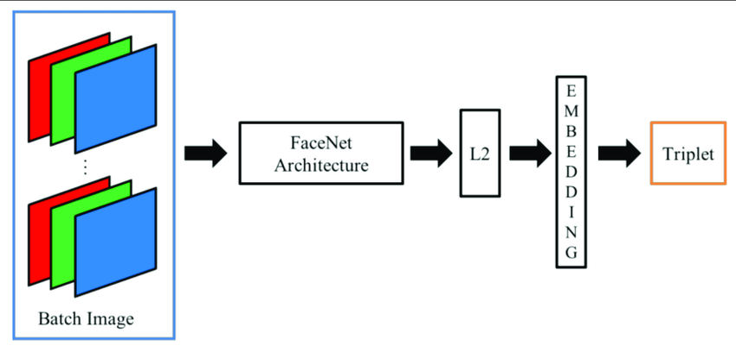
FLOW CHART :

Slide 16
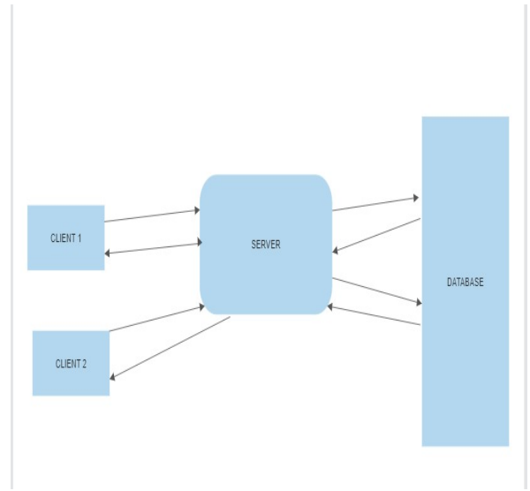
SERVER ARCHITECTURE:
The client-server architecture is a popular distributed computing model that is widely used in modern applications. It consists of two main components: the client and the server. The client is responsible for sending
requests to the server, while the server is responsible for processing those requests and sending back a response.

Slide 17
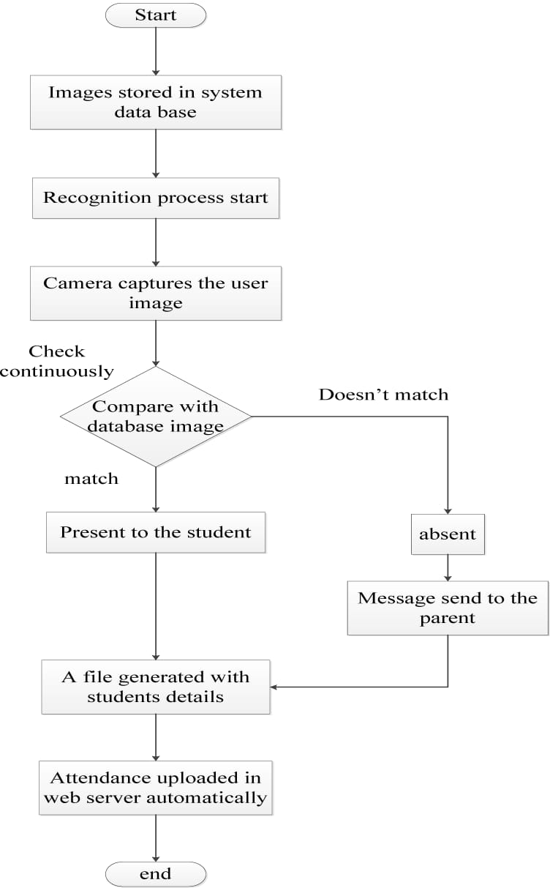

Slide 18
Working :
The app's working is described in the steps below:
Scan a class folder present in the firebase storage. Next, parse all the images present within that folder. A flask server is deployed for this purpose. The flask server stores the images in the form of 64-byte array and then sends this information to the app. The images are then converted to bitmap in the app. We then Crop the face from the image ( the one which was collected from user's storage ) using the bounding box coordinates.
Finally, we have a list of cropped Bitmap of the faces present in the images. Next, feed the cropped Bitmap to the FaceNet model and get the embeddings ( as FloatArray ). Now, we create a HashMap<String,FloatArray> object where we store the names of the sub directories as keys and the embeddings as their corresponding values.

Slide 19
The above procedure is carried out only on the app's startup. The steps below will execute on each camera frame.
Using androidx.camera.core.ImageAnalysis, we construct a FrameAnalyser class which processes the camera frames. Now, for a given frame, we first get the bounding box coordinates ( as a Rect ) of all the faces present in the frame. Crop the face from the frame using these boxes.
Feed the cropped faces to the FaceNet model to generate embeddings for them. We compare the embedding with a suitable metric and form clusters for each user. We compute the average score for each cluster. The cluster with the best score is our output. The final output is then stored as a Prediction and passed to the BoundingBoxOverlay which draws boxes and text.
For multiple images for a single user, we compute the score for each image. An average score is computed for each group. The group with the best score is chosen as the output. See FrameAnalyser.kt.

Slide 20
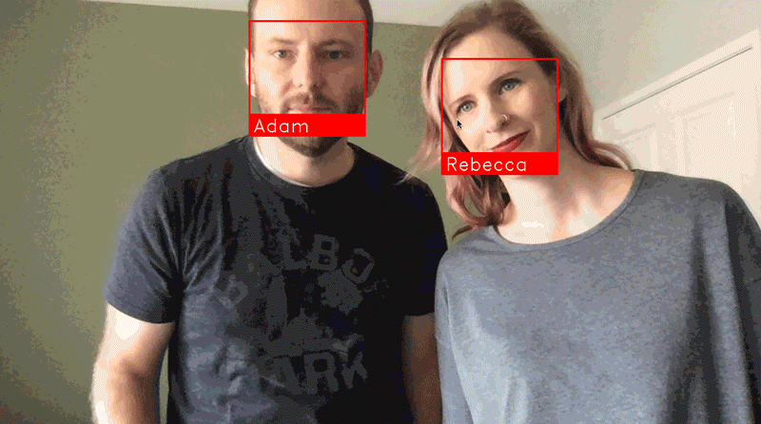

Slide 21
System requirements :
SOFTWARE REQUIREMENTS
FRONT END : Python
BACK END : Kotlin
OPERATING SYSTEM : Android
IDE : Android studio
HARDWARE REQUIREMENTS
Version : android-11
RAM : 4GB
HARD DISK :8GB

Slide 22
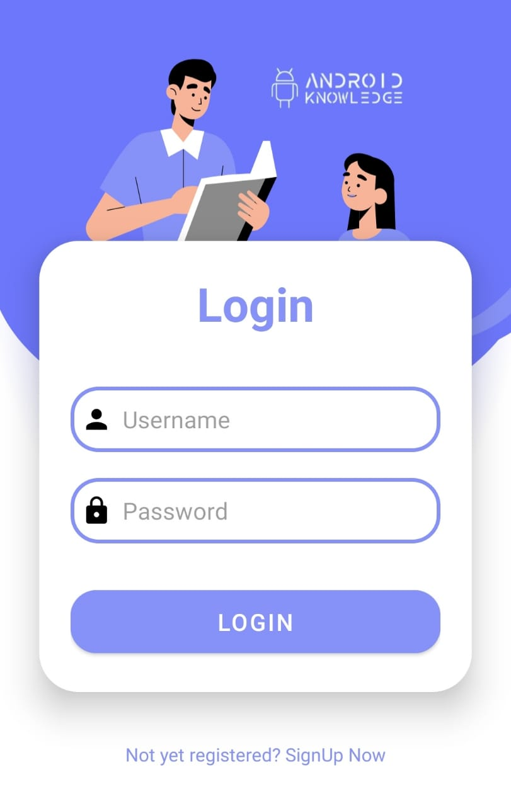
Screen shorts :
The app's startup is a login page

Slide 23
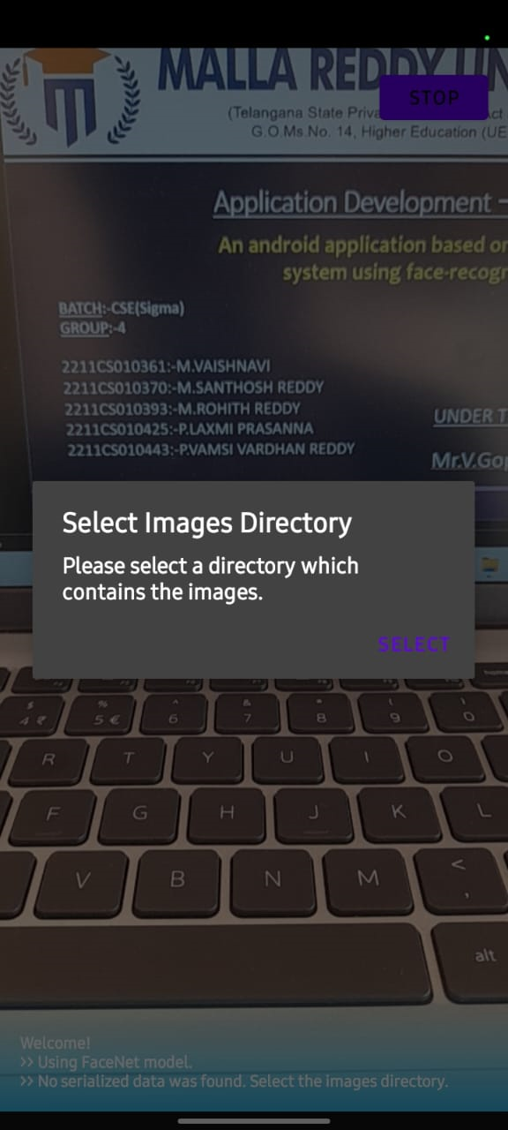
The admin then selects a particular class he wants to check into to mark attendance. Each class click corresponds to get request to the flask server endpoint.

Slide 24
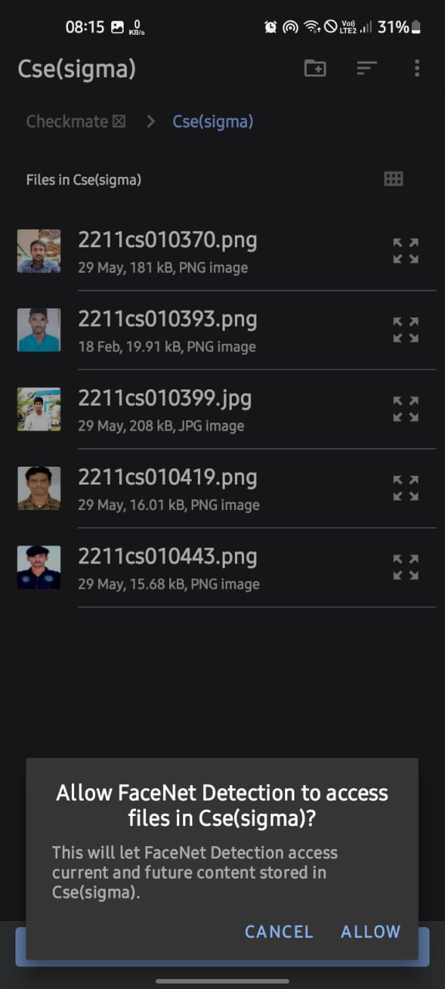
A user/admin need to store the images of a particular group of students belonging to a class in a directory in Firebase storage bucket. The server accesses then accessese the images of a particular class and and then the bitmap information is sent to app. The image shows the class hierarchy

Slide 25
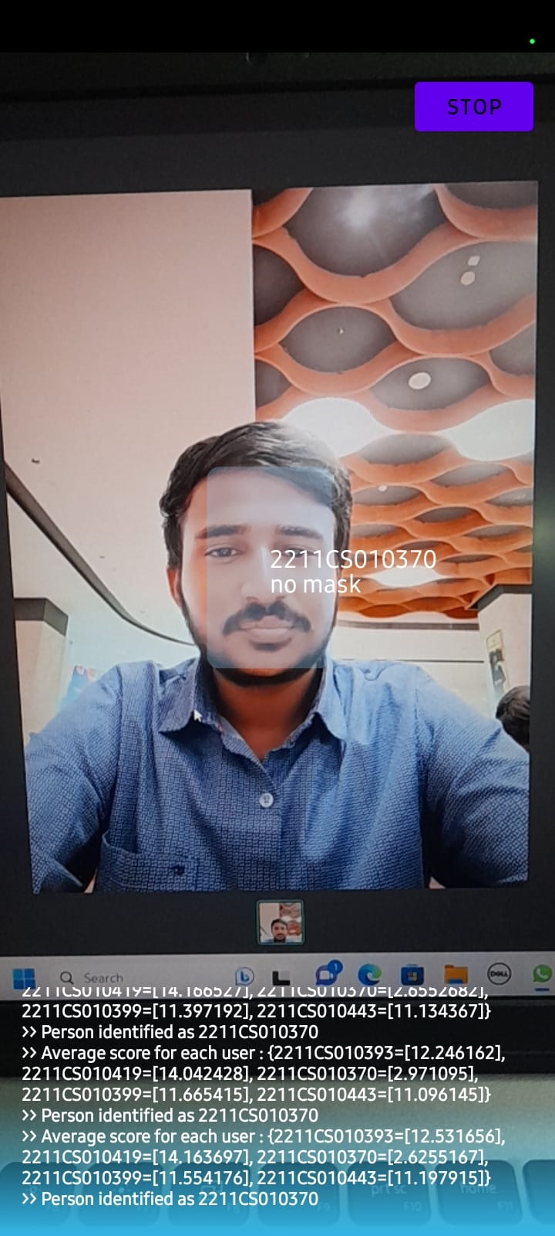
The image refers to the images stored in a particular class. It is recommended to have multiple images of same person in different conditions such as lightning and camera angles. Remember to mark the filename as the student's name or roll number.

Slide 26
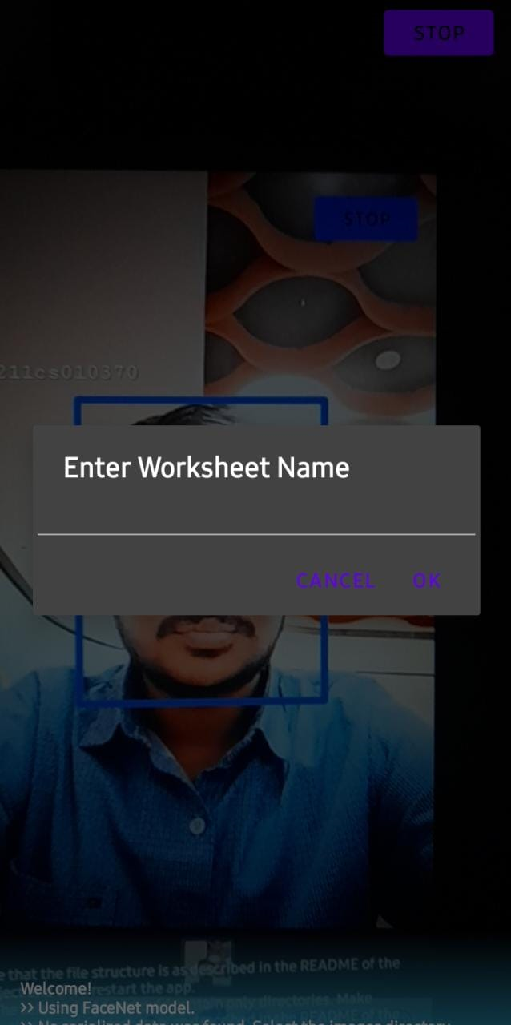
After all the students are marked, upon pressing the stop button, the app asks the admin to enter a name to the excel file to store the attendance status of the students. The students whose faces are detected are marked present and those not detected otherwise.

Slide 27
Limitations
Predictions may go wrong as FaceNet does not always produce similar embeddings for the same person. Consider the accuracy of the FaceNet model while using it in your apps. In that case, you may learn to use the FaceNetModel class separating for using FaceNet in some other tasks.

Slide 28
Conclusion :
Technology when used wisely can benefit a community at large scale. We aim to build an efficient, easy to use end-to-end Mobile Application that serves to reduce inefficiencies in attendance marking with the use of latest cutting edge technology.
This android application will help teachers leverage the use case of excellent technology aided with good accuracy. This will reduce the burden of attendance marking and proxies.

Slide 29
Future work :
This system can be improvised by making it to recognise
students of the whole class accurately. This system can also
be implemented in educational institutions. This system can
be attached to surveillance camera in such a way that the
camera placed in a class captures the image of the whole
class and recognises the students and awards attendances to
available students. This reduces lot of efforts and time for
teaching faculties.

Slide 30


